Slide 2
F5 Agility lab iRules - Security
July 27, 2018
Speaker name, Job Title

Slide 3
Why use iRules for security?

Slide 4
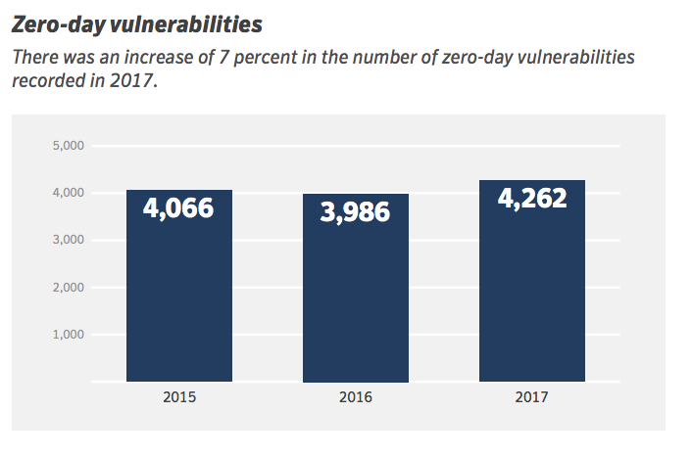
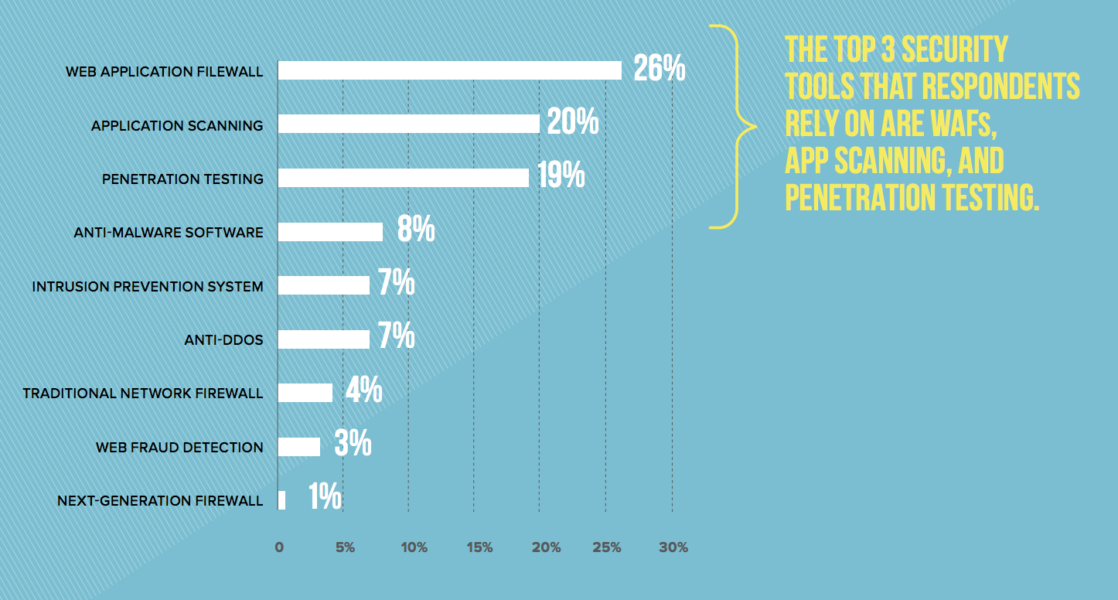
Why use iRules for security?
In 2017 we saw roughly 81 new zero-day vulnerabilities each week
Symantec 2018 Internet Security Threat Report
A significantly large number of security teams are performing little in the way of formal application protection tools/techniques.
In surveys performed for the latest F5labs Application Protection Report, only 36% of respondents say they implement application hardening practices before deploying an application ”most of the time”.
F5Labs 2018 Application Protection Report

Slide 5
Why use iRules for security?
In practice, developers are rarely trained in application security

Slide 6
Why use iRules for security?
iRules present an opportunity to “fix” things that are hard to solve in the application stack

Slide 7
Why use iRules for security?
F5’s full proxy architecture is a strategic point of control for L3-L7 traffic
Independent
proxy-level control
Independent
proxy-level control
Availability
Performance
Security

Slide 8
Security iRule Solutions in today’s lab
TLS Version Control
F5 ASM Hooks
HTTP Throttling
Content Rewrite
HSTS/HPKP
F5 DNS Hooks
Geolocation + L7DoS Hooks
Securing Cookies
All of today’s solutions are presented as a sequence of scenario’s, then solved according to business requirements with an iRule!
©
8

Slide 9

Lab Logistics
Time
Laptop
Enthusiasm
4 short hours
Required for labs
Because knowing how to use iRules for security will make you popular
© 2017 F5 Networks
9

Slide 10

Lab environment
Ravello Cloud Environment
Ubuntu Desktop
Services
RDP
You
BIG-IP VE
Services
Services

Slide 11
TLS Version Control

Slide 12
Connections by TLS version
when CLIENTSSL_HANDSHAKE { ISTATS::incr "ltm.virtual [virtual name] c [SSL::cipher version]" 1 }
[user@murky:Active] ~ # tmsh show ltm virtual stdsslvip
------------------------------------------------------------------
Ltm::Virtual Server: stdsslvip
------------------------------------------------------------------
Status
Availability : available
State : enabled
Reason : The virtual server is available
CMP : enabled
CMP Mode : all-cpus
Destination : 192.168.2.189:443
Traffic ClientSide Ephemeral General
Bits In 872.0K 0 -
Bits Out 3.7M 0 -
Packets In 943 0 -
Packets Out 871 0 -
User-defined Value
SSLv3 21
TLSv1 32
TLSv1.1 54
TLSv1.2 282

Slide 13
TLS version inspection
If the TLS version is less than 1.1, send the user to a “safe” page:
when CLIENTSSL_HANDSHAKE {
if { [SSL::cipher version] equals "TLSV1" or [SSL::cipher version] equals "SSLv3" } {
set redirect "http://www.f5test.local/insecure.html"
SSL::respond "HTTP/1.1 302 Found\r\nLocation: $redirect\r\n\r\n"
}
}

Slide 14
ASM Hooks

Slide 15
F5 ASM Hooks
when ASM_REQUEST_DONE {
# triggered after ASM has finished processing the request and found all violations of the ASM policy.
if { [ASM::status] equals "blocked" } {
# Returns the status of the request after ASM processing
#ASM::violation returns list of violations found in request/response together, further refined with below command options
log local0. "Violation count: [ASM::violation count] "
log local0. "Violation names: [ASM::violation names] "
log local0. "Violation attack types: [ASM::violation attack_types] "
log local0. "Violation details: [ASM::violation details] "
if { [ASM::violation count] <= 1 } {
if { [lindex [ASM::violation names] 0] equals "VIOLATION_HTTP_SANITY_CHECK_FAILED" } {
# ASM::client_ip returns client IP from ASM’s perspective (e.g XFF, Alt-XFF)
if { [ASM::client_ip] equals "10.1.10.51" } {
# Unblocks the request, but will still log/report the violation
ASM::unblock
}
}
}
}
}

Slide 16
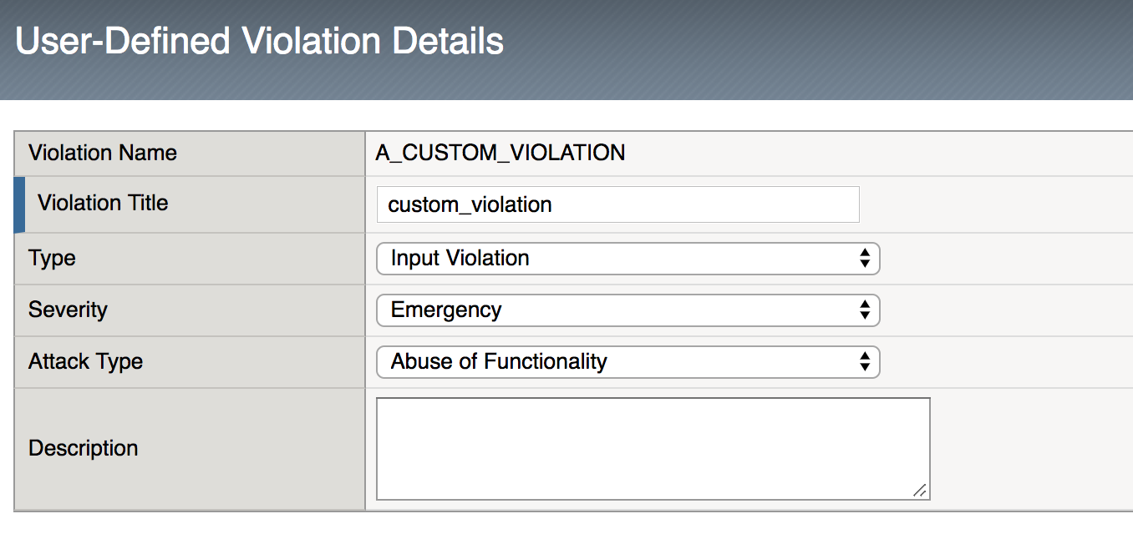
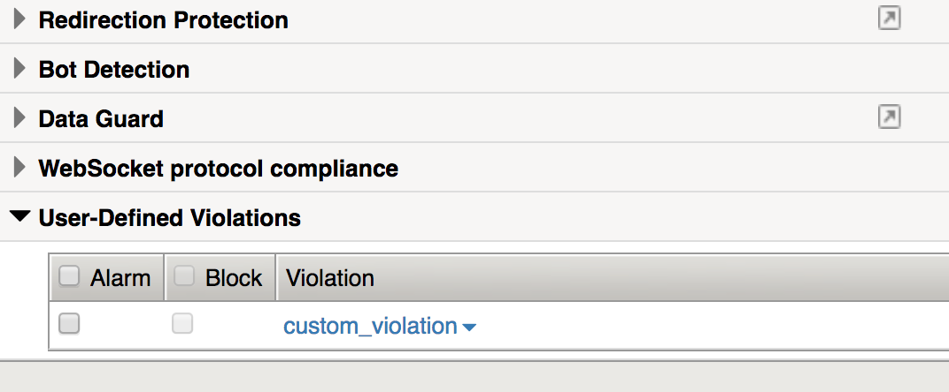
F5 ASM Hooks
Not part of today’s lab scenario, but equally interesting and useful ..
When ASM_REQUEST_DONE {
if {$something_bad_happened } {
set viol_data []
set relevant_data []
set more_relevant_data []
# Below lines add data and context to the custom violation we are going “raise”
lappend relevant_data ”User data collected in iRule” $user_data
lappend more_relevant_data ”Count of bad things user tried to do " $bad_count
lappend viol_data $relevant_data $more_relevant_data
# Raise the violation, and handle according to learning and blocking settings in ASM Policy.
# Appending the context collected above.
ASM::raise A_CUSTOM_VIOLATION $viol_data
}
}

Slide 17
HTTP Throttling

Slide 18
HTTP Throttling
when RULE_INIT {
# This defines the maximum requests to be served within the timing interval defined by the static::timeout variable below.
set static::maxReqs 5;
# Timer Interval in seconds within which only static::maxReqs Requests are allowed.
# (i.e: 10 req per 2 sec == 5 req per sec)
# If this timer expires, it means that the limit was not reached for this interval and the request
# counting starts over.
# Making this timeout large increases memory usage. Making it too small negatively affects performance.
set static::timeout 30;
}
when HTTP_REQUEST {
# The iRule allows throttling for only sepecific Methods. You list the Methods_to_throttle
# in a datagroup. URIs_to_throttle or Methods_to_throttle.
# if you need to throttle by URI use an statement like this:
# if { [class match [HTTP::uri] equals URIs_to_throttle] }
# Note: a URI is everything after the hostname: e.g. /path1/login.aspx?name=user1
#
if { [class match [HTTP::method] equals Methods_to_throttle] } {
# The following expects the IP addresses in multiple X-forwarded-for headers. It picks the first one.
if { [HTTP::header exists X-forwarded-for] } {
set client_IP_addr [getfield [lindex [HTTP::header values X-Forwarded-For] 0] "," 1]
} else {
set client_IP_addr [IP::client_addr]
}
# The matching below expects a datagroup named: Throttling_Whitelist_IPs
# The Condition of the if statement is true if the IP address is NOT in the whitelist.
if { not ([class match $client_IP_addr equals Throttling_Whitelist_IPs ] )} {
set getcount [table lookup -notouch $client_IP_addr]
if { $getcount equals "" } {
table set $client_IP_addr "1" $static::timeout $static::timeout
# record of this session does not exist, starting new record, request is allowed.
} else {
if { $getcount < $static::maxReqs } {
log local0. "Request Count for $client_IP_addr is $getcount"
table incr -notouch $client_IP_addr
# record of this session exists but request is allowed.
} else {
HTTP::respond 403 content {
<html>
<head><title>HTTP Request denied</title></head>
<body>Your HTTP requests are being throttled.</body>
</html>
}
}
}
}
}
}

Slide 19
HTTP Throttling
when RULE_INIT {
# This defines the maximum requests to be served within the timing interval defined by the static::timeout variable below.
set static::maxReqs 5;
# Timer Interval in seconds within which only static::maxReqs Requests are allowed.
# (i.e: 10 req per 2 sec == 5 req per sec)
# If this timer expires, it means that the limit was not reached for this interval and the request
# counting starts over.
# Making this timeout large increases memory usage. Making it too small negatively affects performance.
set static::timeout 30;
}
when HTTP_REQUEST {
# The iRule allows throttling for only sepecific Methods. You list the Methods_to_throttle
# in a datagroup. URIs_to_throttle or Methods_to_throttle.
# if you need to throttle by URI use an statement like this:
# if { [class match [HTTP::uri] equals URIs_to_throttle] }
# Note: a URI is everything after the hostname: e.g. /path1/login.aspx?name=user1
#
if { [class match [HTTP::method] equals Methods_to_throttle] } {
# The following expects the IP addresses in multiple X-forwarded-for headers. It picks the first one.
if { [HTTP::header exists X-forwarded-for] } {
set client_IP_addr [getfield [lindex [HTTP::header values X-Forwarded-For] 0] "," 1]
} else {
set client_IP_addr [IP::client_addr]
}
# The matching below expects a datagroup named: Throttling_Whitelist_IPs
# The Condition of the if statement is true if the IP address is NOT in the whitelist.
if { not ([class match $client_IP_addr equals Throttling_Whitelist_IPs ] )} {
set getcount [table lookup -notouch $client_IP_addr]
if { $getcount equals "" } {
table set $client_IP_addr "1" $static::timeout $static::timeout
# record of this session does not exist, starting new record, request is allowed.
} else {
if { $getcount < $static::maxReqs } {
log local0. "Request Count for $client_IP_addr is $getcount"
table incr -notouch $client_IP_addr
# record of this session exists but request is allowed.
} else {
HTTP::respond 403 content {
<html>
<head><title>HTTP Request denied</title></head>
<body>Your HTTP requests are being throttled.</body>
</html>
}
}
}
}
}
}

Slide 20
HTTP Throttling
when RULE_INIT {
# This defines the maximum requests to be served within the timing interval defined by the static::timeout variable below.
set static::maxReqs 5;
# Timer Interval in seconds within which only static::maxReqs Requests are allowed.
# (i.e: 10 req per 2 sec == 5 req per sec)
# If this timer expires, it means that the limit was not reached for this interval and the request
# counting starts over.
# Making this timeout large increases memory usage. Making it too small negatively affects performance.
set static::timeout 30;
}
when HTTP_REQUEST {
# The iRule allows throttling for only sepecific Methods. You list the Methods_to_throttle
# in a datagroup. URIs_to_throttle or Methods_to_throttle.
# if you need to throttle by URI use an statement like this:
# if { [class match [HTTP::uri] equals URIs_to_throttle] }
# Note: a URI is everything after the hostname: e.g. /path1/login.aspx?name=user1
#
if { [class match [HTTP::method] equals Methods_to_throttle] } {
# The following expects the IP addresses in multiple X-forwarded-for headers. It picks the first one.
if { [HTTP::header exists X-forwarded-for] } {
set client_IP_addr [getfield [lindex [HTTP::header values X-Forwarded-For] 0] "," 1]
} else {
set client_IP_addr [IP::client_addr]
}
# The matching below expects a datagroup named: Throttling_Whitelist_IPs
# The Condition of the if statement is true if the IP address is NOT in the whitelist.
if { not ([class match $client_IP_addr equals Throttling_Whitelist_IPs ] )} {
set getcount [table lookup -notouch $client_IP_addr]
if { $getcount equals "" } {
table set $client_IP_addr "1" $static::timeout $static::timeout
# record of this session does not exist, starting new record, request is allowed.
} else {
if { $getcount < $static::maxReqs } {
log local0. "Request Count for $client_IP_addr is $getcount"
table incr -notouch $client_IP_addr
# record of this session exists but request is allowed.
} else {
HTTP::respond 403 content {
<html>
<head><title>HTTP Request denied</title></head>
<body>Your HTTP requests are being throttled.</body>
</html>
}
}
}
}
}
}
Subtable:
204.79.192.200
1 | ignore
2 | ignore
3 | ignore
4 | ignore
5 | ignore

Slide 21
HTTP Throttling
when RULE_INIT {
# This defines the maximum requests to be served within the timing interval defined by the static::timeout variable below.
set static::maxReqs 5;
# Timer Interval in seconds within which only static::maxReqs Requests are allowed.
# (i.e: 10 req per 2 sec == 5 req per sec)
# If this timer expires, it means that the limit was not reached for this interval and the request
# counting starts over.
# Making this timeout large increases memory usage. Making it too small negatively affects performance.
set static::timeout 30;
}
when HTTP_REQUEST {
# The iRule allows throttling for only sepecific Methods. You list the Methods_to_throttle
# in a datagroup. URIs_to_throttle or Methods_to_throttle.
# if you need to throttle by URI use an statement like this:
# if { [class match [HTTP::uri] equals URIs_to_throttle] }
# Note: a URI is everything after the hostname: e.g. /path1/login.aspx?name=user1
#
if { [class match [HTTP::method] equals Methods_to_throttle] } {
# The following expects the IP addresses in multiple X-forwarded-for headers. It picks the first one.
if { [HTTP::header exists X-forwarded-for] } {
set client_IP_addr [getfield [lindex [HTTP::header values X-Forwarded-For] 0] "," 1]
} else {
set client_IP_addr [IP::client_addr]
}
# The matching below expects a datagroup named: Throttling_Whitelist_IPs
# The Condition of the if statement is true if the IP address is NOT in the whitelist.
if { not ([class match $client_IP_addr equals Throttling_Whitelist_IPs ] )} {
set getcount [table lookup -notouch $client_IP_addr]
if { $getcount equals "" } {
table set $client_IP_addr "1" $static::timeout $static::timeout
# record of this session does not exist, starting new record, request is allowed.
} else {
if { $getcount < $static::maxReqs } {
log local0. "Request Count for $client_IP_addr is $getcount"
table incr -notouch $client_IP_addr
# record of this session exists but request is allowed.
} else {
HTTP::respond 403 content {
<html>
<head><title>HTTP Request denied</title></head>
<body>Your HTTP requests are being throttled.</body>
</html>
}
}
}
}
}
}
Subtable:
204.79.192.200
1 | ignore
2 | ignore
3 | ignore
4 | ignore
5 | ignore

Slide 22
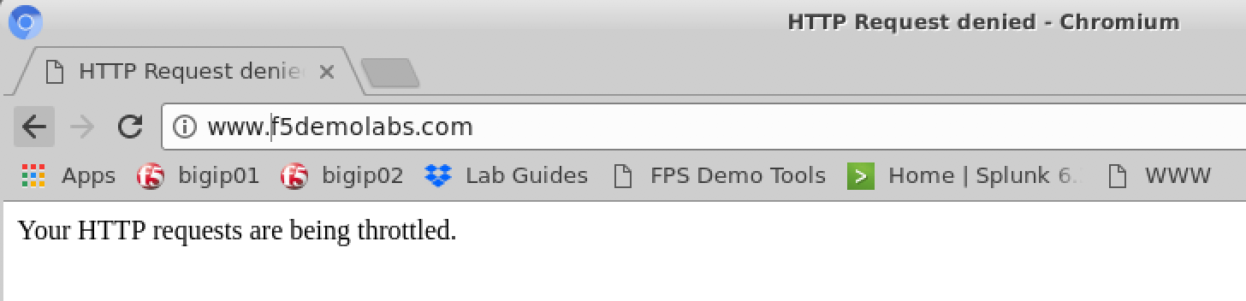
HTTP Throttling
when RULE_INIT {
# This defines the maximum requests to be served within the timing interval defined by the static::timeout variable below.
set static::maxReqs 5;
# Timer Interval in seconds within which only static::maxReqs Requests are allowed.
# (i.e: 10 req per 2 sec == 5 req per sec)
# If this timer expires, it means that the limit was not reached for this interval and the request
# counting starts over.
# Making this timeout large increases memory usage. Making it too small negatively affects performance.
set static::timeout 30;
}
when HTTP_REQUEST {
# The iRule allows throttling for only sepecific Methods. You list the Methods_to_throttle
# in a datagroup. URIs_to_throttle or Methods_to_throttle.
# if you need to throttle by URI use an statement like this:
# if { [class match [HTTP::uri] equals URIs_to_throttle] }
# Note: a URI is everything after the hostname: e.g. /path1/login.aspx?name=user1
#
if { [class match [HTTP::method] equals Methods_to_throttle] } {
# The following expects the IP addresses in multiple X-forwarded-for headers. It picks the first one.
if { [HTTP::header exists X-forwarded-for] } {
set client_IP_addr [getfield [lindex [HTTP::header values X-Forwarded-For] 0] "," 1]
} else {
set client_IP_addr [IP::client_addr]
}
# The matching below expects a datagroup named: Throttling_Whitelist_IPs
# The Condition of the if statement is true if the IP address is NOT in the whitelist.
if { not ([class match $client_IP_addr equals Throttling_Whitelist_IPs ] )} {
set getcount [table lookup -notouch $client_IP_addr]
if { $getcount equals "" } {
table set $client_IP_addr "1" $static::timeout $static::timeout
# record of this session does not exist, starting new record, request is allowed.
} else {
if { $getcount < $static::maxReqs } {
log local0. "Request Count for $client_IP_addr is $getcount"
table incr -notouch $client_IP_addr
# record of this session exists but request is allowed.
} else {
HTTP::respond 403 content {
<html>
<head><title>HTTP Request denied</title></head>
<body>Your HTTP requests are being throttled.</body>
</html>
}
}
}
}
}
}

Slide 23
Content Rewrite

Slide 24
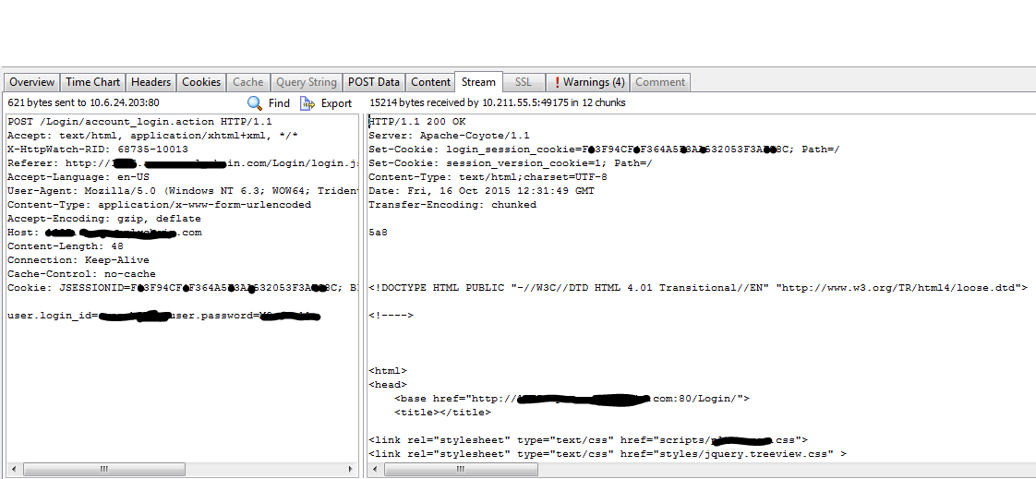
What is wrong with this picture?

Slide 25
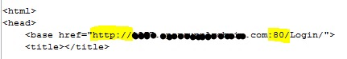
What is wrong with this picture?

Slide 26
Solution: content rewrite
when HTTP_RESPONSE {
# Explicitly disable the stream profile for each request so it doesn’t stay
# enabled for subsequent HTTP requests on the same TCP connection
STREAM::disable
HTTP::header remove “Accept-Encoding”
}
When HTTP_RESPONSE {
# Apply stream profile against text responses from the application
if { [HTTP::header value Content-Type] contains "text"} {
# Look for http:// and replace it with https://
STREAM::expression “@http://@https://@”
# Enable the stream profile
STREAM::enable
}
}

Slide 27
Solution: content rewrite
when HTTP_RESPONSE {
# Explicitly disable the stream profile for each request so it doesn’t stay
# enabled for subsequent HTTP requests on the same TCP connection
STREAM::disable
HTTP::header remove “Accept-Encoding”
}
When HTTP_RESPONSE {
# Apply stream profile against text responses from the application
if { [HTTP::header value Content-Type] contains "text"} {
# Look for http:// and replace it with https://
STREAM::expression “@http://@https://@”
# Enable the stream profile
STREAM::enable
}
}
STREAM::expression “@\d3-\d2-\d4@***-**-****@ @\d4-\d4-\d4-\d4@xxxx-xxxx-xxxx-xxxx@”

Slide 28
Solution: content rewrite, open a new browser tab
Devcentral member Asks:
Just wonder is that possible when user click the web site link and F5 will assist to open a new tab for new page instead ?
Example : when user access to www.test.com and click on the "contact" button link . Then, f5 will assist open a new tab.

Slide 29
Solution: content rewrite, open a new browser tab
Devcentral member Asks:
Just wonder is that possible when user click the web site link and F5 will assist to open a new tab for new page instead ?
Example : when user access to www.test.com and click on the "contact" button link . Then, f5 will assist open a new tab .
Another Devcentral member responds:
this would be possible using a STREAM Profile or by using an iRule using the [STREAM::enable], [STREAM::disable] and [STREAM::expression] syntax. Basically you have to change the "contact" button related HTML content so that it instructs the browser to open the link in a new Window/Tab.
If the original code looks like this...
<a href="http://www.test.com/contact.html">Contact</a>
... it has to be changed to ...
<a href="http://www.test.com/contact.html" target="_blank">Contact</a>
The STREAM expression would then look like this...
@www.test.com/contact.html\">@www.test.com/contact.html\" target=\"_blank\">@
- Kai Wilkie, member devcentral.f5.com

Slide 30
HSTS / HPKP

Slide 31
What is HSTS / HPKP?
HTTP Strict Transport Security (per OWASP and RFC 6797)
An opt-in security enhancement that is specified by a web application through the use of a special response header. Once a supported browser receives this header that browser will prevent any communications from being sent over HTTP to the specified domain and will instead send all communications over HTTPS. It also prevents HTTPS click through prompts on browsers.
Strict-Transport-Security: max-age=31536000; includeSubDomains
Header name
1 year
Optional: include all subdomains

Slide 32
What is HSTS / HPKP?
HTTP Strict Transport Security (per OWASP and RFC 6797)
An opt-in security enhancement that is specified by a web application through the use of a special response header. Once a supported browser receives this header that browser will prevent any communications from being sent over HTTP to the specified domain and will instead send all communications over HTTPS. It also prevents HTTPS click through prompts on browsers.
Strict-Transport-Security: max-age=31536000; includeSubDomains
HTTP Public Key Pinning (per OWASP and RFC 7469 and also referred to as “HTTP Pinning”)
A new HTTP header that allows SSL servers to declare hashes of their certificates with time scope in which these certificates should not be changed.
Public-Key-Pins: max-age=2592000;
pin-sha256="E9CZ9INDbd+2eRQozYqqbQ2yXLVKB9+xcprMF+44U1g=";
pin-sha256="LPJNul+wow4m6DsqxbninhsWHlwfp0JecwQzYpOLmCQ=";
report-uri="http://example.com/pkp-report"
Header name
1 year
Optional: include all subdomains

Slide 33
HSTS / HPKP
when RULE_INIT {
set static::fqdn_pin1 "X3pGTSOuJeEVw989IJ/cEtXUEmy52zs1TZQrU06KUKg=”
# Set max_age to 180 days
set static::max_age 15552000
}
when HTTP_RESPONSE {
# Insert an HSTS header
HTTP::header insert Strict-Transport-Security "max-age=$static::max_age; includeSubDomains”
# Insert an HPKP header
HTTP::header insert Public-Key-Pins "pin-sha256=\"$static::fqdn_pin1\" max-age=$static::max_age; includeSubDomains”
}

Slide 34
HSTS / HPKP
when RULE_INIT {
set static::fqdn_pin1 "X3pGTSOuJeEVw989IJ/cEtXUEmy52zs1TZQrU06KUKg=”
# Set max_age to 180 days
set static::max_age 15552000
}
when HTTP_RESPONSE {
# Insert an HSTS header
HTTP::header insert Strict-Transport-Security "max-age=$static::max_age; includeSubDomains”
# Insert an HPKP header
HTTP::header insert Public-Key-Pins "pin-sha256=\"$static::fqdn_pin1\" max-age=$static::max_age; includeSubDomains”
}
openssl x509 -in <cert> -pubkey -noout |openssl rsa -pubin -outform der |openssl dgst -sha256 -binary |openssl enc -base64

Slide 35
HSTS / HPKP
when RULE_INIT {
set static::fqdn_pin1 "X3pGTSOuJeEVw989IJ/cEtXUEmy52zs1TZQrU06KUKg=”
# Set max_age to 180 days
set static::max_age 15552000
}
when HTTP_RESPONSE {
# Insert an HSTS header
HTTP::header insert Strict-Transport-Security "max-age=$static::max_age; includeSubDomains”
# Insert an HPKP header
HTTP::header insert Public-Key-Pins "pin-sha256=\"$static::fqdn_pin1\" max-age=$static::max_age; includeSubDomains”
}
Always insert the HTTP header in an HTTPS response

Slide 36
HSTS / HPKP
when RULE_INIT {
set static::fqdn_pin1 "X3pGTSOuJeEVw989IJ/cEtXUEmy52zs1TZQrU06KUKg=”
# Set max_age to 180 days
set static::max_age 15552000
}
when HTTP_RESPONSE {
# Insert an HSTS header
HTTP::header insert Strict-Transport-Security "max-age=$static::max_age; includeSubDomains”
# Insert an HPKP header
HTTP::header insert Public-Key-Pins "pin-sha256=\"$static::fqdn_pin1\" max-age=$static::max_age; includeSubDomains”
}
user types: www.google.com
browser requests: https://www.google.com

Slide 37
Secure your cookies

Slide 38
Secure your cookies
Cookies not marked secure by application
No HttpOnly flag
Failing an audit?
Vulnerable to XSS attack?
when HTTP_RESPONSE {
set ckname “mycookie"
if { [HTTP::cookie exists $ckanme } {
HTTP::cookie secure $ckname enable
HTTP::cookie httponly $ckname enable
}
}
A secure cookie can only be transmitted over an encrypted connection (i.e. HTTPS).
HttpOnly cookies can only be used when transmitted via HTTP (or HTTPS). They are not accessible through non-HTTP APIs such as JavaScript. This restriction eliminates the threat of cookie theft via cross-site scripting (XSS)

Slide 39
F5 DNS Hooks

Slide 40
Geolocation + L7DoS hooks

Slide 41
Geolocation
when HTTP_REQUEST {
set XFF [getfield [lindex [HTTP::header values X-Forwarded-For] 0] “,” 1]
log local0. “continent: [whereis ${XFF} continent]”
log local0. “country: [whereis ${XFF} country]”
log local0. “state: [whereis ${XFF} state]”
log local0. “isp: [whereis ${XFF} isp]”
log local0. “org: [whereis ${XFF} org]”
}
[whereis [IP::client_addr] continent] – returns the continent
[whereis [IP::client_addr] country] – returns the continent
[whereis [IP::client_addr] <state|abbrev>] – returns the state information as word or as two-letter abbreviation
[whereis [IP::client_addr] isp] – returns the carrier
[whereis [IP::client_addr] org] - returns the registered organization

Slide 42
Geolocation
when HTTP_REQUEST {
set XFF [getfield [lindex [HTTP::header values X-Forwarded-For] 0] ”,” 1]
if { [whereis ${XFF} country] ne “US” } {
drop
event disable all
}
}
when HTTP_REQUEST {
set XFF [getfield [lindex [HTTP::header values X-Forwarded-For] “,” 1]
if { not ( [class match [whereis ${XFF} country] equals list_of_countries ] )} {
#log local0. “[whereis ${XFF} country] is not a part of accepted countries, traffic is dropped”
drop
event disable all
}
}
ltm data-group internal list_of_countries {
type string
records {
US {}
CA {}
IN {}
LB {}
}
}

Slide 43
Geolocation
when HTTP_REQUEST {
set XFF [getfield [lindex [HTTP::header values X-Forwarded-For] 0] ”,” 1]
if { [whereis ${XFF} country] ne “US” } {
drop
event disable all
}
}
when HTTP_REQUEST {
set XFF [getfield [lindex [HTTP::header values X-Forwarded-For] “,” 1]
if { not ( [class match [whereis ${XFF} country] equals list_of_countries ] )} {
#log local0. “[whereis ${XFF} country] is not a part of accepted countries, traffic is dropped”
drop
event disable all
}
}
ltm data-group internal list_of_countries {
type string
records {
US {}
CA {}
IN {}
LB {}
}
}

Slide 44
L7DOS - BOTDEFENSE
when BOTDEFENSE_ACTION {
# triggered immediately prior to botdefense feature taking an action
log local0. " Geolocation Country: [whereis $XFF country] "
log local0. " Bot Defense Status: [BOTDEFENSE::reason] "
log local0. " Bot Defense Action: [BOTDEFENSE::action] ”
log local0. ” Bot Defense Bot Sig: [BOTDEFENSE::bot_signature] “
log local0. “ Bot Defense Device ID: [BOTDEFENSE::device_id] “
}
[BOTDEFENSE::action ] – allows for set or override of action, sample options include: allow, browser_challenge, tcp_rst,redirect_with_cookie, custom_response,
BOTDEFENSE::enable – enables processing and blocking of the request by Bot Defense
BOTDEFENSE::disable – disables processing and blocking of the request by Bot Defense
BOTDEFENSE::previous_action – returns action taken by previous request, applicable if current request is a follow-up to challenge
BOTDEFENSE::support_id - returns the support ID of the request

Slide 45
Geolocation + L7DoS – Combining Context
When HTTP_REQUEST {
# Checks value of inbound XFF against geolocation database, then take action
if {!([whereis $XFF country] equals "RU")} {
log local0. "De-activating PBD: Not Russia source"
# disables BOTDEFENSE for all bot requests originating from Russia
BOTDEFENSE::disable
}
}

Slide 46
Client Certificate Inspection

Slide 47
Client Certificate Inspection
when RULE_INIT {
set static::debug 1
}
when CLIENTSSL_CLIENTCERT {
# Example Subject DN: /C=AU/ST=NSW/L=Syd/O=Your Organization/OU=Your OU/CN=John Smith
set subject_dn [X509::subject [SSL::cert 0]]
if { $subject_dn != "" } {
if { $static::debug }{ log "Client Certificate received: $subject_dn” }
}
}
when HTTP_REQUEST {
if { [HTTP::uri] starts_with "/" } {
if { $subject_dn contains "CN=Whitfield Diffe" } {
HTTP::uri /whitfielddiffe/index.html
} elseif { $subject_dn contains “CN=Martin Hellman” } {
HTTP::uri /martinhellman/index.html
} {
reject
}
}
}

Slide 48
Client Certificate Inspection
when RULE_INIT {
set static::debug 1
}
when CLIENTSSL_CLIENTCERT {
# Example Subject DN: /C=AU/ST=NSW/L=Syd/O=Your Organisation/OU=Your OU/CN=John Smith
set subject_dn [X509::subject [SSL::cert 0]]
if { $subject_dn != "" } {
if { $static::debug }{ log "Client Certificate received: $subject_dn” }
}
}
when HTTP_REQUEST {
if { [HTTP::uri] starts_with "/" } {
if { $subject_dn contains "CN=Whitfield Diffe" } {
HTTP::uri /whitfielddiffe/index.html
} elseif { $subject_dn contains “CN=Martin Hellman” } {
HTTP::uri /martinhellman/index.html
} {
reject
}
}
}

Slide 49
Client Certificate Inspection
Services
John Smith
Services
Policy Services
Services
when RULE_INIT {
set static::debug 1
}
when CLIENTSSL_CLIENTCERT {
# Example Subject DN: /C=AU/ST=NSW/L=Syd/O=Your Organization/OU=Your OU/CN=John Smith
set subject_dn [X509::subject [SSL::cert 0]]
if { $subject_dn != "" } {
if { $static::debug }{ log "Client Certificate received: $subject_dn” }
}
}
when HTTP_REQUEST {
if { [HTTP::uri] starts_with "/" } {
if { $subject_dn contains "CN=Whitfield Diffe" } {
HTTP::uri /whitfielddiffe/index.html
} elseif { $subject_dn contains “CN=Martin Hellman” } {
HTTP::uri /martinhellman/index.html
} {
reject
}
}
}

Slide 50
IP Reputation

Slide 51
IP Reputation
when HTTP_REQUEST {
# Use [HTTP::header values "X-Forwarded-For"] in replacement of [IP::client_addr] if using the x-forwarded-for
# for testing
# set iprep_categories [IP::reputation [IP::client_addr]]
set iprep categories [IP::reputation [HTTP::header values “X-Forwarded-For]]
set is_reject 0
if { $iprep_categories contains "Windows Exploits" } {
set is_reject 1
}
if { $iprep_categories contains "Web Attacks" } {
set is_reject 1
}
if { $iprep_categories contains "Scanners" } {
set is_reject 1
}
if { $iprep_categories contains "Proxy" } {
set is_reject 1
}
if { $is_reject } {
log local0. "Attempted access from malicious IP address [HTTP::header values “X-Forwarded-For]($iprep_categories) - rejected"
HTTP::respond 200 content "<HTML><HEAD><TITLE>Rejected Request</TITLE></HEAD>
<BODY>The request was rejected. <BR>Attempted access from malicious IP address</BODY>
</HTML>”
}
}

Slide 52
IP Reputation
when HTTP_REQUEST {
# Use [HTTP::header values "X-Forwarded-For"] in replacement of [IP::client_addr] if using the x-forwarded-for
# for testing
# set iprep_categories [IP::reputation [IP::client_addr]]
set iprep_categories [IP::reputation [HTTP::header values “X-Forwarded-For]]
set is_reject 0
if { $iprep_categories contains "Windows Exploits" } {
set is_reject 1
}
if { $iprep_categories contains "Web Attacks" } {
set is_reject 1
}
if { $iprep_categories contains "Scanners" } {
set is_reject 1
}
if { $iprep_categories contains "Proxy" } {
set is_reject 1
}
if { $is_reject } {
log local0. "Attempted access from malicious IP address [IP::client_addr]($iprep_categories) - rejected"
HTTP::respond 200 content "<HTML><HEAD><TITLE>Rejected Request</TITLE></HEAD>
<BODY>The request was rejected. <BR>Attempted access from malicious IP address</BODY>
</HTML>”
}
}

Slide 53
IP Reputation
when HTTP_REQUEST {
# Use [HTTP::header values "X-Forwarded-For"] in replacement of [IP::client_addr] if using the x-forwarded-for
# for testing
# set iprep_categories [IP::reputation [IP::client_addr]]
set iprep_categories [IP::reputation [HTTP::header values “X-Forwarded-For]]
set is_reject 0
if { $iprep_categories contains "Windows Exploits" } {
set is_reject 1
}
if { $iprep_categories contains "Web Attacks" } {
set is_reject 1
}
if { $iprep_categories contains "Scanners" } {
set is_reject 1
}
if { $iprep_categories contains "Proxy" } {
set is_reject 1
}
if { $is_reject } {
log local0. "Attempted access from malicious IP address [IP::client_addr]($iprep_categories) - rejected"
HTTP::respond 200 content "<HTML><HEAD><TITLE>Rejected Request</TITLE></HEAD>
<BODY>The request was rejected. <BR>Attempted access from malicious IP address</BODY>
</HTML>”
}
}

Slide 54
IP Reputation
when HTTP_REQUEST {
# Use [HTTP::header values "X-Forwarded-For"] in replacement of [IP::client_addr] if using the x-forwarded-for
# for testing
# set iprep_categories [IP::reputation [IP::client_addr]]
set iprep_categories [IP::reputation [HTTP::header values “X-Forwarded-For]]
set is_reject 0
if { $iprep_categories contains "Windows Exploits" } {
set is_reject 1
}
if { $iprep_categories contains "Web Attacks" } {
set is_reject 1
}
if { $iprep_categories contains "Scanners" } {
set is_reject 1
}
if { $iprep_categories contains "Proxy" } {
set is_reject 1
}
if { $is_reject } {
log local0. "Attempted access from malicious IP address [IP::client_addr]($iprep_categories) - rejected"
HTTP::respond 200 content "<HTML><HEAD><TITLE>Rejected Request</TITLE></HEAD>
<BODY>The request was rejected. <BR>Attempted access from malicious IP address</BODY>
</HTML>”
}
}

Slide 55
Updates to Template
We have added ten new Title slides to the template.
To keep the file size of your presentation down we recommend that you delete the unused Title slides from BOTH the light and dark Masters.
Select View, Slide Master and delete unused Title Masters.
If you cannot delete it means that Master is in use.

Slide 56
Dark and Light Template
This template has multiple sections which can be found in the thumbnail display to the left (slide tab).
F5-Corporate-Template-Dark
F5-Corporate-Template-Light
Design Examples
Photography
F5 Icons
Template Recommendations
In this area or the master layouts you can access either the dark or light template. Remember to delete the various sections to the left.
Do not use layout options in the “design—this will change fonts, colors, etc. and your presentation will no longer look like an F5 presentation.

Slide 57
Example of a Title and Bulleted Content Slide
Please keep content to no more than 7 bullets
When emphasizing content, use bold with red color
Bullet placeholder number three
Bullet placeholder number four
Bullet placeholder number five
Bullet placeholder number six
Bullet placeholder number seven

Slide 58
Example of a Bulleted Content Slide
Main Topic 1: Size 32pt
Size 24 for the sub topics
Size 24 for the sub topics
Main Topic 2: Size 32pt
Size 24 for the sub topics
Size 24 for the sub topics
Main Topic 3: Size 32pt
Size 24 for the sub topics
Size 24 for the sub topics

Slide 59
Example of a 2-Column Bulleted Content Slide
Main Topic 1: Size 32pt
Size 24 for the sub topics
Size 24 for the sub topics
Main Topic 2: Size 32pt
Size 24 for the sub topics
Size 24 for the sub topics
Main Topic 3: Size 32pt
Size 24 for the sub topics
Size 24 for the sub topics
Main Topic 4: Size 32pt
Size 24 for the sub topics
Size 24 for the sub topics
Main Topic 5: Size 32pt
Size 24 for the sub topics
Size 24 for the sub topics
Main Topic 6: Size 32pt
Size 24 for the sub topics
Size 24 for the sub topics

Slide 60
Example of Bulleted Content w/Sub-header
Sub-header: Size 32pt
Main Topic 1: Size 32pt
Size 24 for the sub topics
Size 24 for the sub topics
Size 24 for the sub topics
Main Topic 2: Size 32pt
Size 24 for the sub topics
Size 24 for the sub topics
Size 24 for the sub topics

Slide 61
Example of a 2-Column Bulleted w/Sub-header
Sub-header: Size 32pt
Main Topic 1: Size 32pt
Size 24 for the sub topics
Size 24 for the sub topics
Size 24 for the sub topics
Main Topic 2: Size 32pt
Size 24 for the sub topics
Size 24 for the sub topics
Size 24 for the sub topics
Main Topic 3: Size 32pt
Size 24 for the sub topics
Size 24 for the sub topics
Size 24 for the sub topics
Main Topic 4: Size 32pt
Size 24 for the sub topics
Size 24 for the sub topics
Size 24 for the sub topics

Slide 62
Example of a Really, Really, Really Long Two-Line Title and Bulleted Content Slide
Main Topic 1: Size 32pt
Size 24 for the sub topics
Size 24 for the sub topics
Size 24 for the sub topics
Main Topic 2: Size 32pt
Size 24 for the sub topics
Size 24 for the sub topics
Size 24 for the sub topics

Slide 63
Example of a Really, Really, Really Long Two-Line Title and 2-Column Bulleted Slide
Main Topic 1: Size 32pt
Size 24 for the sub topics
Size 24 for the sub topics
Size 24 for the sub topics
Main Topic 2: Size 32pt
Size 24 for the sub topics
Size 24 for the sub topics
Size 24 for the sub topics
Main Topic 3: Size 32pt
Size 24 for the sub topics
Size 24 for the sub topics
Size 24 for the sub topics
Main Topic 4: Size 32pt
Size 24 for the sub topics
Size 24 for the sub topics
Size 24 for the sub topics

Slide 64
SEGUE SLIDE

Slide 65
What we’re about
OUR MISSION
Decentralized App Delivery
75%
45%
Secure
Fast
Available
Stephen Chow VP of Design and Branding

Slide 66
20%
75%
45%
Charts are editable. Right-click on chart and select Edit Data.

Slide 67
Example of a Horizontal Bar Chart
Charts are editable. Right-click on chart and select Edit Data.

Slide 68
Example of a Table
Header 1 | Header 2 | Header 3
Content 1 | Content 2 | Content 3

Slide 69
AMERICAS
EMEA
ASIA-PACIFIC

Slide 70
MONTH DATE, YEAR
MONTH DATE, YEAR
MONTH DATE, YEAR
TODAY
TUESDAY
WEDNESDAY
Decentralized App Delivery
Secured App Delivery
Fast App Delivery
PRESENTED BY:
PRESENTED BY:
PRESENTED BY:
Stephen Chow VP of Design and Branding
Dave Ramsey EVP of Marketing
Joe Bloggs CEO

Slide 71


Headline would go here. Max 2 lines.
Here you can have up to 3 lines of subtext or content. Whatever you wish you have is fine.

Slide 72

Headline would go here. Max 2 lines.
Here you can have up to 3 lines of subtext or content. Whatever you wish you have is fine.

Slide 73
“Your famous quote goes here. You can use bold to create emphasis.”
Author’s Name Title Placeholder

Slide 74
PATHWAYS TO YOUR DATA
01100110 00110101 00001101 00001010
COMPROMISED USER IDENTITY
VULNERABLE APPLICATIONS
VULNERABLE DATA

Slide 75
Thank You

Slide 78
Presentation Title Placeholder
Date Placeholder: Month, Day, Year
Speaker Name, Job Title

Slide 79
Example of a Title and Bulleted Content Slide
Please keep content to no more than 7 bullets
When emphasizing content, use bold with red color
Bullet placeholder number three
Bullet placeholder number four
Bullet placeholder number five
Bullet placeholder number six
Bullet placeholder number seven

Slide 80
Example of a Bulleted Content Slide
Main Topic 1: Size 32pt
Size 24 for the sub topics
Size 24 for the sub topics
Main Topic 2: Size 32pt
Size 24 for the sub topics
Size 24 for the sub topics
Main Topic 3: Size 32pt
Size 24 for the sub topics
Size 24 for the sub topics

Slide 81
Example of a 2-Column Bulleted Content Slide
Main Topic 1: Size 32pt
Size 24 for the sub topics
Size 24 for the sub topics
Main Topic 2: Size 32pt
Size 24 for the sub topics
Size 24 for the sub topics
Main Topic 3: Size 32pt
Size 24 for the sub topics
Size 24 for the sub topics
Main Topic 4: Size 32pt
Size 24 for the sub topics
Size 24 for the sub topics
Main Topic 5: Size 32pt
Size 24 for the sub topics
Size 24 for the sub topics
Main Topic 6: Size 32pt
Size 24 for the sub topics
Size 24 for the sub topics

Slide 82
Example of Bulleted Content w/Sub-header
Sub-header: Size 32pt
Main Topic 1: Size 32pt
Size 24 for the sub topics
Size 24 for the sub topics
Size 24 for the sub topics
Main Topic 2: Size 32pt
Size 24 for the sub topics
Size 24 for the sub topics
Size 24 for the sub topics

Slide 83
Example of a 2-Column Bulleted w/Sub-header
Sub-header: Size 32pt
Main Topic 1: Size 32pt
Size 24 for the sub topics
Size 24 for the sub topics
Size 24 for the sub topics
Main Topic 2: Size 32pt
Size 24 for the sub topics
Size 24 for the sub topics
Size 24 for the sub topics
Main Topic 3: Size 32pt
Size 24 for the sub topics
Size 24 for the sub topics
Size 24 for the sub topics
Main Topic 4: Size 32pt
Size 24 for the sub topics
Size 24 for the sub topics
Size 24 for the sub topics

Slide 84
Example of a Really, Really, Really Long Two-Line Title and Bulleted Content Slide
Main Topic 1: Size 32pt
Size 24 for the sub topics
Size 24 for the sub topics
Size 24 for the sub topics
Main Topic 2: Size 32pt
Size 24 for the sub topics
Size 24 for the sub topics
Size 24 for the sub topics

Slide 85
Example of a Really, Really, Really Long Two-Line Title and 2-Column Bulleted Slide
Main Topic 1: Size 32pt
Size 24 for the sub topics
Size 24 for the sub topics
Size 24 for the sub topics
Main Topic 2: Size 32pt
Size 24 for the sub topics
Size 24 for the sub topics
Size 24 for the sub topics
Main Topic 3: Size 32pt
Size 24 for the sub topics
Size 24 for the sub topics
Size 24 for the sub topics
Main Topic 4: Size 32pt
Size 24 for the sub topics
Size 24 for the sub topics
Size 24 for the sub topics

Slide 86
Segue slide

Slide 87
What we’re about
OUR MISSION
Decentralized App Delivery
75%
45%
Secure
Fast
Available
Stephen Chow VP of Design and Branding

Slide 88
20%
75%
45%
Charts are editable. Right-click on chart and select Edit Data.

Slide 89
Example of a Horizontal Bar Chart
Charts are editable. Right-click on chart and select Edit Data.

Slide 90
Example of a Table
Header 1 | Header 2 | Header 3
Content 1 | Content 2 | Content 3

Slide 91
MONTH DATE, YEAR
MONTH DATE, YEAR
MONTH DATE, YEAR
TODAY
TUESDAY
WEDNESDAY
Decentralized App Delivery
Secured App Delivery
Fast App Delivery
PRESENTED BY:
PRESENTED BY:
PRESENTED BY:
Stephen Chow VP of Design and Branding
Dave Ramsey EVP of Marketing
Joe Bloggs CEO

Slide 92
Headline would go here. Max 2 lines.
Here you can have up to 3 lines of subtext or content. Whatever you wish you have is fine.

Slide 93
Headline would go here. Max 2 lines.
Here you can have up to 3 lines of subtext or content. Whatever you wish you have is fine.

Slide 94
AMERICAS
EMEA
ASIA-PACIFIC

Slide 95
“Your famous quote goes here. You can use bold to create emphasis.”
Author’s Name Title Placeholder

Slide 96
PATHWAYS TO YOUR DATA
01100110 00110101 00001101 00001010
COMPROMISED USER IDENTITY
VULNERABLE APPLICATIONS
VULNERABLE DATA

Slide 97
Thank You

Slide 99
Agenda example

Slide 100
MONTH DATE, YEAR
MONTH DATE, YEAR
MONTH DATE, YEAR
TODAY
TUESDAY
WEDNESDAY
Main Title Placeholder 1
Main Title Placeholder 2
Main Title Placeholder 3
PRESENTED BY:
PRESENTED BY:
PRESENTED BY:
Name Placeholder Title Placeholder
Name Placeholder Title Placeholder
Name Placeholder Title Placeholder

Slide 101
MONTH DATE, YEAR
MONTH DATE, YEAR
MONTH DATE, YEAR
MONDAY
TODAY
WEDNESDAY
Main Title Placeholder 1
Main Title Placeholder 2
Main Title Placeholder 3
PRESENTED BY:
PRESENTED BY:
PRESENTED BY:
Name Placeholder Title Placeholder
Name Placeholder Title Placeholder
Name Placeholder Title Placeholder

Slide 102
MONTH DATE, YEAR
MONTH DATE, YEAR
MONTH DATE, YEAR
TODAY
TUESDAY
TODAY
Main Title Placeholder 1
Main Title Placeholder 2
Main Title Placeholder 3
PRESENTED BY:
PRESENTED BY:
PRESENTED BY:
Name Placeholder Title Placeholder
Name Placeholder Title Placeholder
Name Placeholder Title Placeholder

Slide 103

17
The average organization is planning to deploy 17 application services in the next 12 months.

Slide 104
Icon grid example

Slide 106
photography

Slide 107
Please find photo library here.

Slide 108
Icons

Slide 109
[ calendar ]
[ customer support ]
[ ROI chart ]
[ location ]
[ download ]
[ video ]
[ user ]
[ multiple users ]
[ meeting ]
[ e-commerce ]
[ health ]
[ email ]
[ email w/ arrow]
[ WiFi ]
[ antenna ]
[ firewall ]
[ hybrid cloud ]
[ cloud ]
Icon colors are changeable as needed. Please use the “Shape Fill” tool to change them.

Slide 110
[ Internet ]
[ alt. Internet ]
[ storage ]
[ cloud storage ]
[ database ]
[ cloud database ]
[ application ]
[ framework ]
[ scalability ]
[ innovation ]
[ compliance ]
[ time ]
[ performance ]
[ simplified architecture ]
[ program / control ]
[ integration ]
[ flexibility ]
[ DNS ]
Icon colors are changeable as needed. Please use the “Shape Fill” tool to change them.

Slide 111
[ DDoS protection ]
[ security compliance ]
[ identity ]
[ secure ]
[ unsecure ]
[ access ]
[ inspection ]
[ attacker ]
[ code log ]
[ buildings ]
[ WAN ]
[network complexity ]
[ data ]
[ data ]
[ CPU ]
[ FPGA ]
[ alt. FPGA ]
Icon colors are changeable as needed. Please use the “Shape Fill” tool to change them.

Slide 112
[ desktop ]
[ desktop reporting ]
[ desktop e-commerce ]
[ laptop ]
[ infected laptop ]
[ mobile hotspot laptop ]
[ smartphone ]
[ authenticated phone ]
[ mobile hotspot phone ]
[ tablet ]
[ mobile hotspot tablet ]
Icon colors are changeable as needed. Please use the “Shape Fill” tool to change them.

Slide 113
DevOps
(Developers/Operations)
NetOps
(Network Operations)
Super NetOps
(Network Operations)
DevSecOps
(Developer/Security Operations)
SecOps
(Security Operations)
Super NetOps
(Alt.Version Network Operations)
[ financial decision maker ]
[ time reduced ]
[ cost reduced ]
[ euro reduced ]
[ yen reduced ]
[ mulit-currency
cost reduced ]
[ cost structure ]
[ alt. finance ]
[ finance w/dollar ]
[ finance w/euro ]
[ finance w/yen ]
[ finance ]
Icon colors are changeable as needed. Please use the “Shape Fill” tool to change them.

Slide 114
[ roles-based
access control ]
[ security signatures ]
[ SSL (offload)
decrypt/encrypt ]
[ SSL certificate ]
[ device certificate ]
[ key pair ]
[ alt. key pair ]
[ healthcare ]
[ ecommerce ]
[ automotive ]
[ education ]
[ manufacturing ]
[ alt. manufacturing ]
[ media ]
[ size reduced ]
[ explosive growth ]
[ ADC ]
[ global ADC ]
Icon colors are changeable as needed. Please use the “Shape Fill” tool to change them.

Slide 115
[ WAF ]
[ threat campaigns ]
[ device identification ]
[ API protocol security ]
[ API vulnerabilities ]
[ automated attacks ]
[ (app) vulnerabilities
& exploits ]
[ credential & data theft ]
[ low & slow DDoS ]
[ proactive bot defenses ]
[ anti-bot mobile SDK ]
Icon colors are changeable as needed. Please use the “Shape Fill” tool to change them.

Slide 116
[ agility ]
[ 24/7 availability ]
[ government ]
[ publishing ]
[ analytics ]
[ monitoring ]
[ alt. monitoring ]
[ central manager ]
[ orchestrator ]
[ provisioning ]
[ automation ]
[ microservices ]
[ alt. microservices ]
[ containers ]
Icon colors are changeable as needed. Please use the “Shape Fill” tool to change them.

Slide 117
[ multi-cloud ]
[ cloud interconnection ]
[ switch ]
[ router ]
[ blade servers ]
[ hyperconverged ]
[ virtualized app ]
[ iHealth report ]
[ cloud solution template ]
[ F5 iApp ]
[ connector or plug-in ]
[ container connector ]
[ alt. container connector ]
[ multi-cloud connector ]
[ application connector ]
Icon colors are changeable as needed. Please use the “Shape Fill” tool to change them.

Slide 118
[ BIG-IP iSeries ]
[ VIPRION ]
[ virtual edition (VE) ]
[ cloud edition (CE) ]
[ cloud edition (CE) ]
[ subscription licensing ]
Icon colors are changeable as needed. Please use the “Shape Fill” tool to change them.

Slide 119
Icon colors are changeable as needed. Please use the “Shape Fill” tool to change them.

Slide 120
[ bitcoin ]
[ thumbs up ]
[ thumbs down ]
[ happy ]
[ sad ]
[ WAF - fully-managed ]
[ WAF - self-service ]
[ multi-cloud operations ]
[ faster deployments ]
Icon colors are changeable as needed. Please use the “Shape Fill” tool to change them.

Slide 121
Please find diagram icons here.

Slide 122
recommendations

Slide 123
9 Common Mistakes to Avoid in Your Presentation
On-premises, not on-premise. One is not the plural of the other—they are not interchangeable, but two completely different words. A premise is a proposition, whereas a premises is a tract of land.
BIG-IP. All caps, with hyphen. Not Big-IP, BIG IP, Big IP, or any other variation.
BIG-IP DNS. Not BIG-IP Global Traffic Manager or BIG-IP GTM.
BIG-IQ. All caps, with hyphen. Not Big-IQ, BIG IQ, Big IQ, or any other variation.
Silverline, cap S, lowercase l. Not SilverLine.
Data center, two words. Not datacenter.
No trademarks necessary. You do not need to include any trademarks in your presentations—please strip them all out.
Size matters. If the font size is too small for your audience to read, it’s worthless.
Don’t forget spell-check. It’s free, it’s fast, it can save you face.
You can find the complete F5 Content Style Guide here.

Slide 124
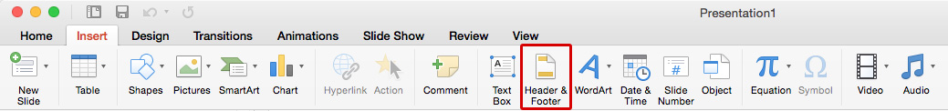
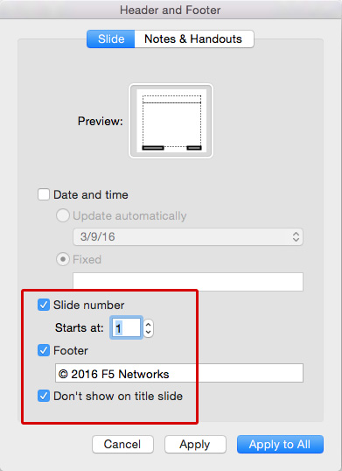
Turning on the Header & Footer
Go to the Insert tab, and click on Header & Footer.
You will get a pop-up box. Make sure the Slide tab is selected and not the Notes & Handouts tab.
Make sure to the Slide number, Footer, and Don’t show on title slide boxes are all checked.
Select Apply to All *Note if you choose Apply it will only apply to that single slide.

